Slide 1

Securing Supply Chain Network with Blockchain
Presented by: Dr. Rabia Riaz
Notes:
Start with introduction

Slide 2
Table of Contents
01
Main Problem !
02
Our Solution :)
Issues with Current Supply Chain
Implementing this with Blockchain
03
Why Blockchain?
04
Market Potential
Transparency, Immutability, and more
Needs of this approch
05
Software Overview
06
Key Players
UI elements and Functionalities
Leading companies working on supply Chain
07
Credits
08
Thank you
Founder and supporters
A wonderful serenity has taken
2

Slide 3
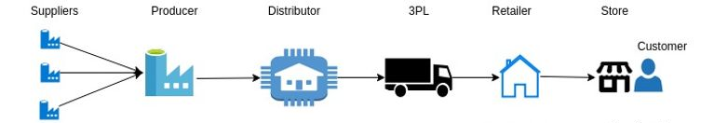
Main Problem !
Lack of end-to-end visibility
Less transparency and productivity
Lack of trust among
all stakeholders
Lack of digitalization
3

Slide 4

Solution is Blockchain :)

Slide 5
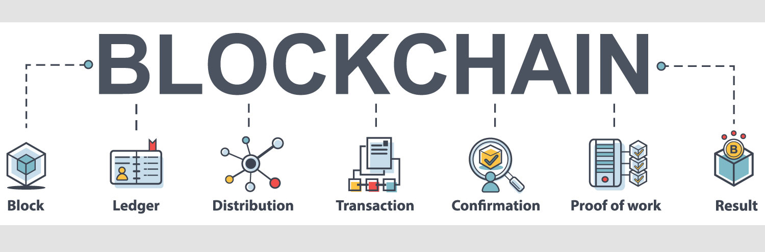
What is Blockchain
Distributed, Immutable, Database, Cryptographically link with previous block
5

Slide 6
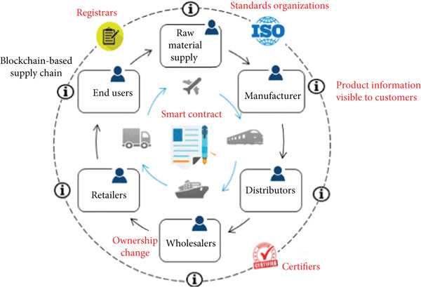
Why Blockchain?
Transparency and Traceability
#1
#2
Security
#3
Decentralized ledger
#4
Immutability
6

Slide 7
Market Potential of Supply Chain Blockchain
Market Analysis 22-2028
As per the analysis shared by our research analyst, the Blockchain Technology in Supply Chain Management Market is expected to grow annually at a CAGR of around 51.3 % (2022-2028).
Global Market Size year 2017
51.3%
The global blockchain supply chain market size was valued at $ 93.16 million in 2017,
48.7%
Expected Growth After Year 2025
It projected to reach $ 9,852.91 million by 2025.
7

Slide 8
Key Players
IBM (US)
Huawei (China)
Microsoft (US)
SAP (Germany)
AWS (US)
Auxesis Group (India)
Oracle (US)
Guardtime (Estonia)
8

Slide 9
Founder of Blockchain
Credits
Supporters
Respected Parents
9

Slide 10
Thank You

